Slide 1

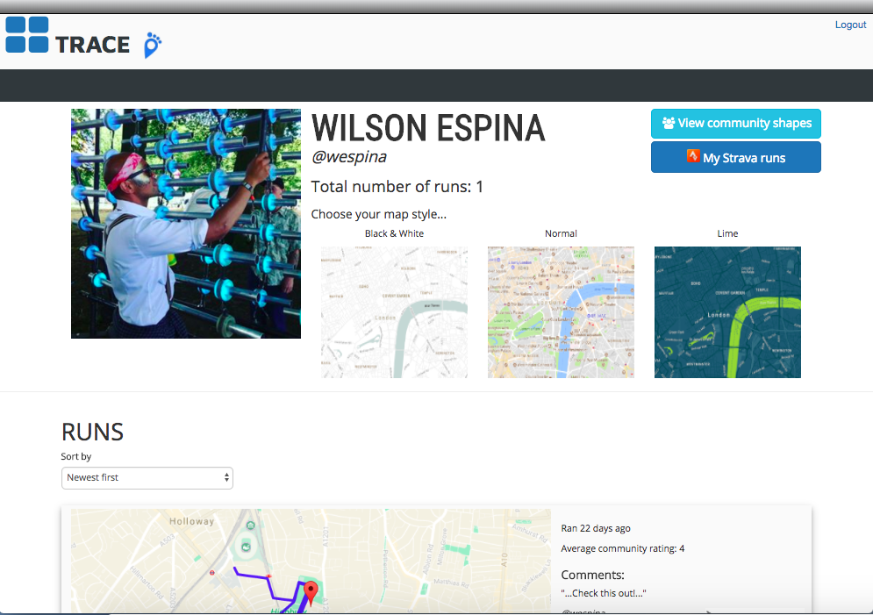
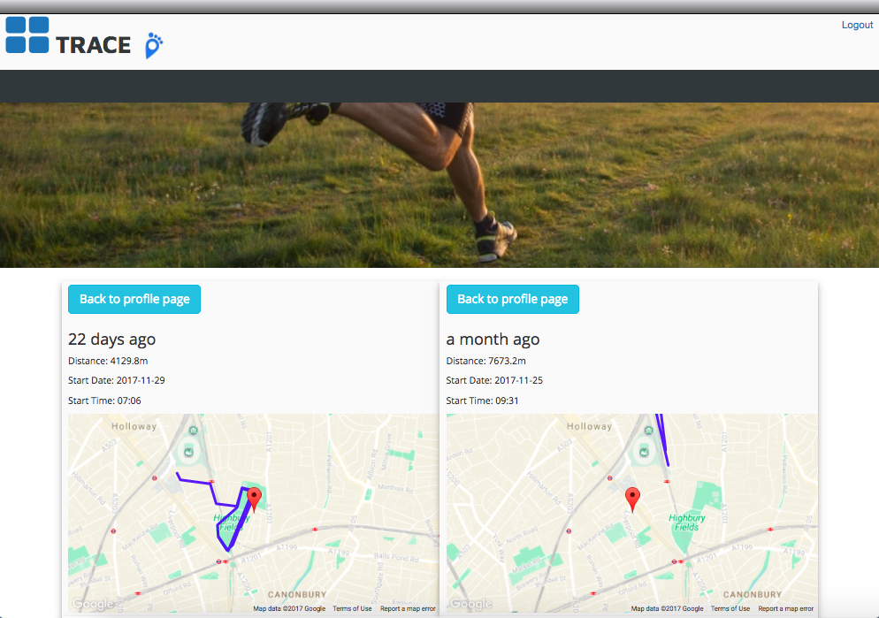
LANDING PAGE
USERS INDEX PAGE
PROFILE PAGE

Slide 2

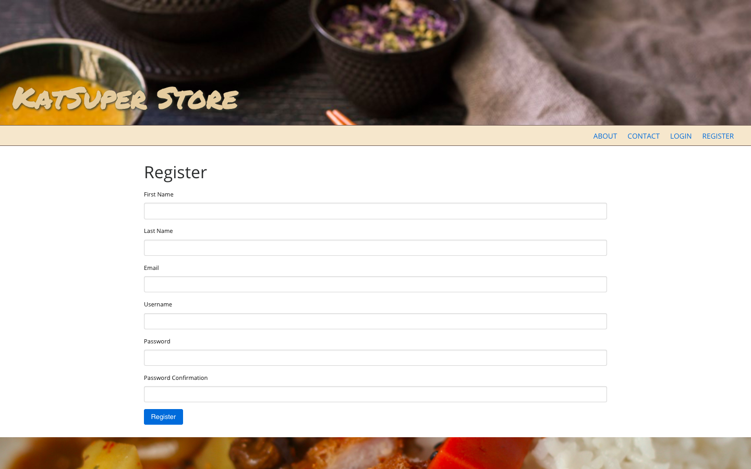
LANDING PAGE
REGISTER PAGE

Slide 3

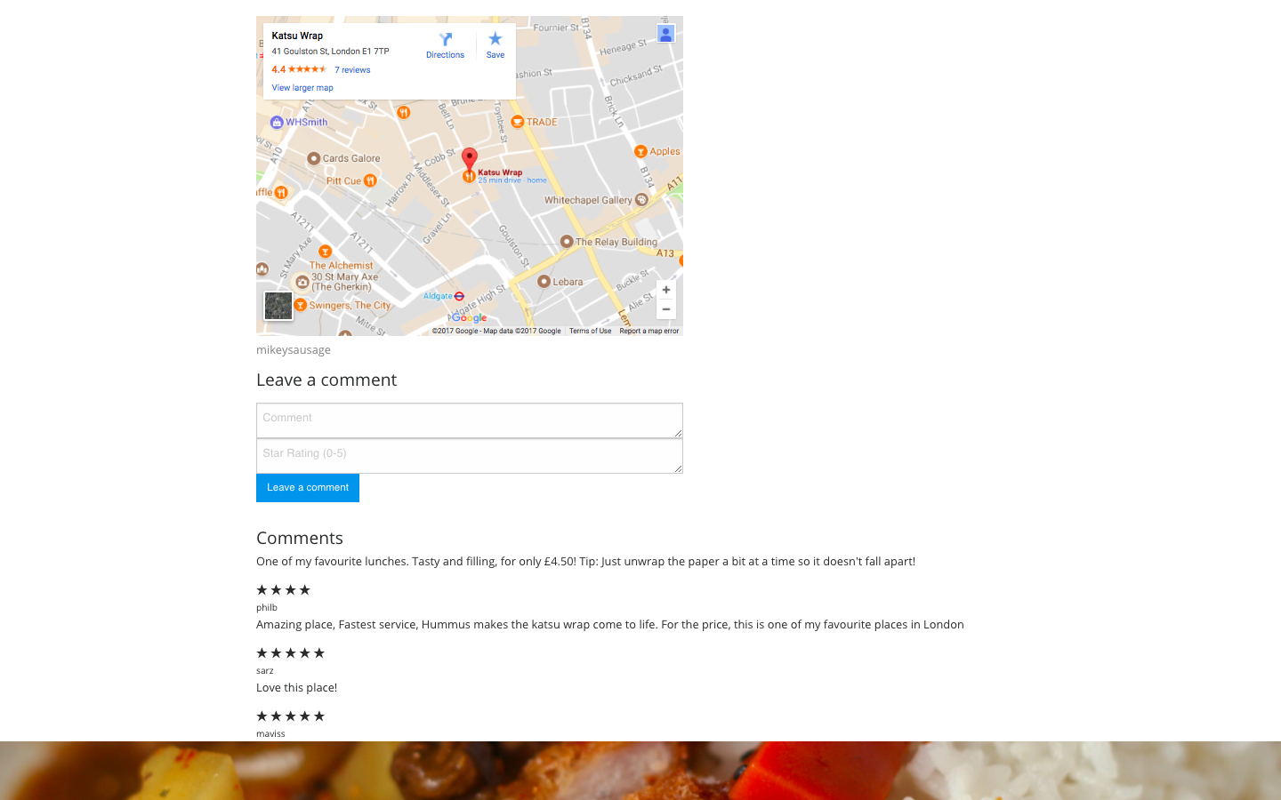
INDEX PAGE
SHOW PAGE

Slide 4

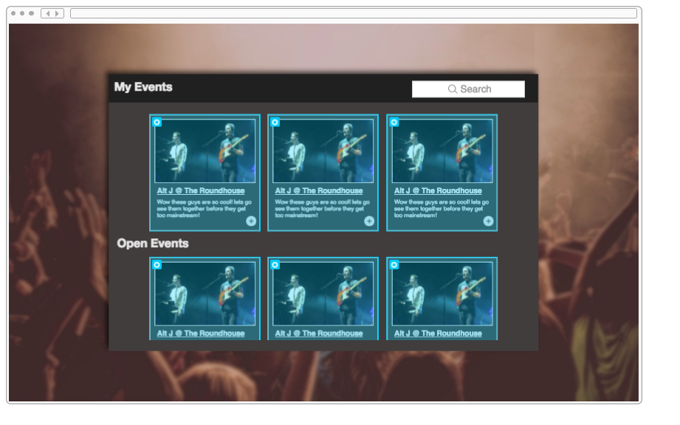
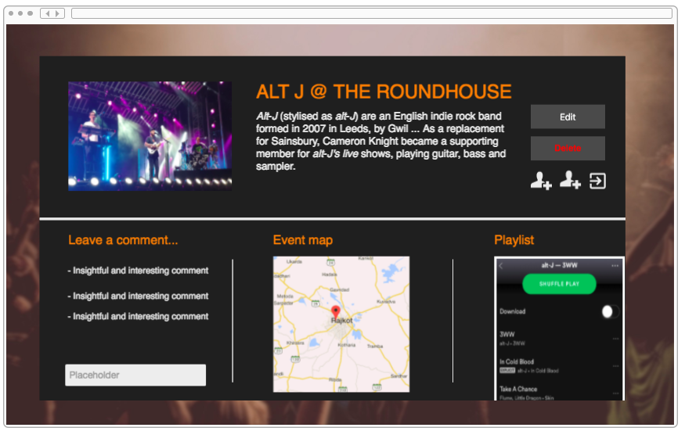
LANDING PAGE
INDEX PAGE
SHOW PAGE

Slide 5
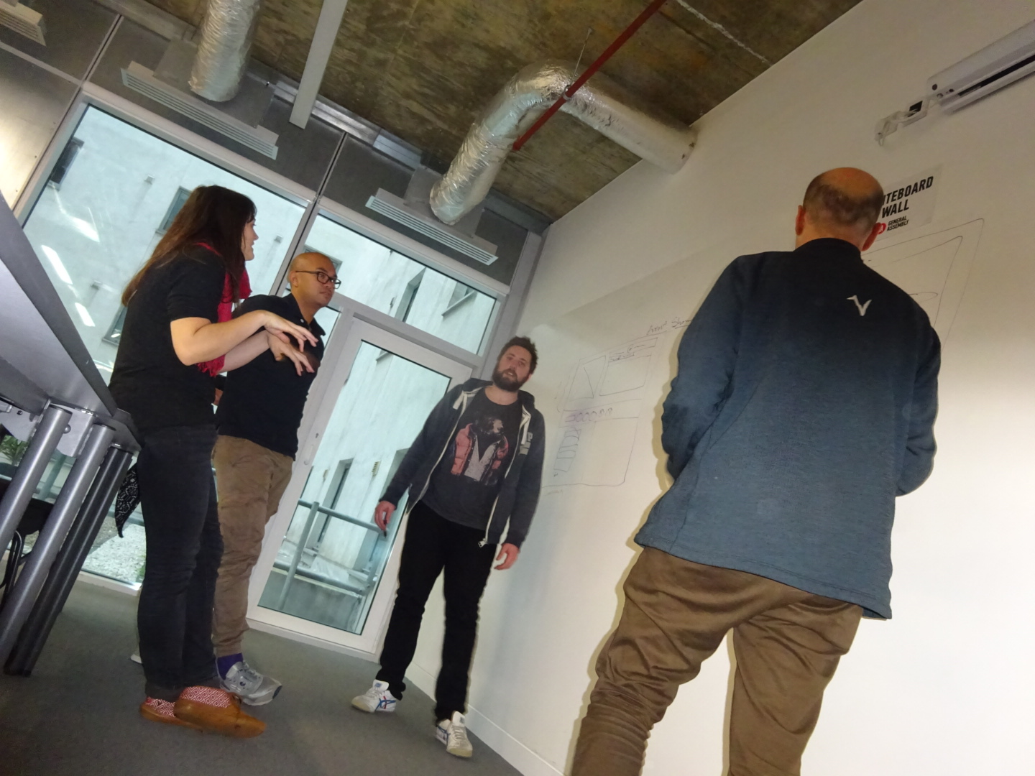
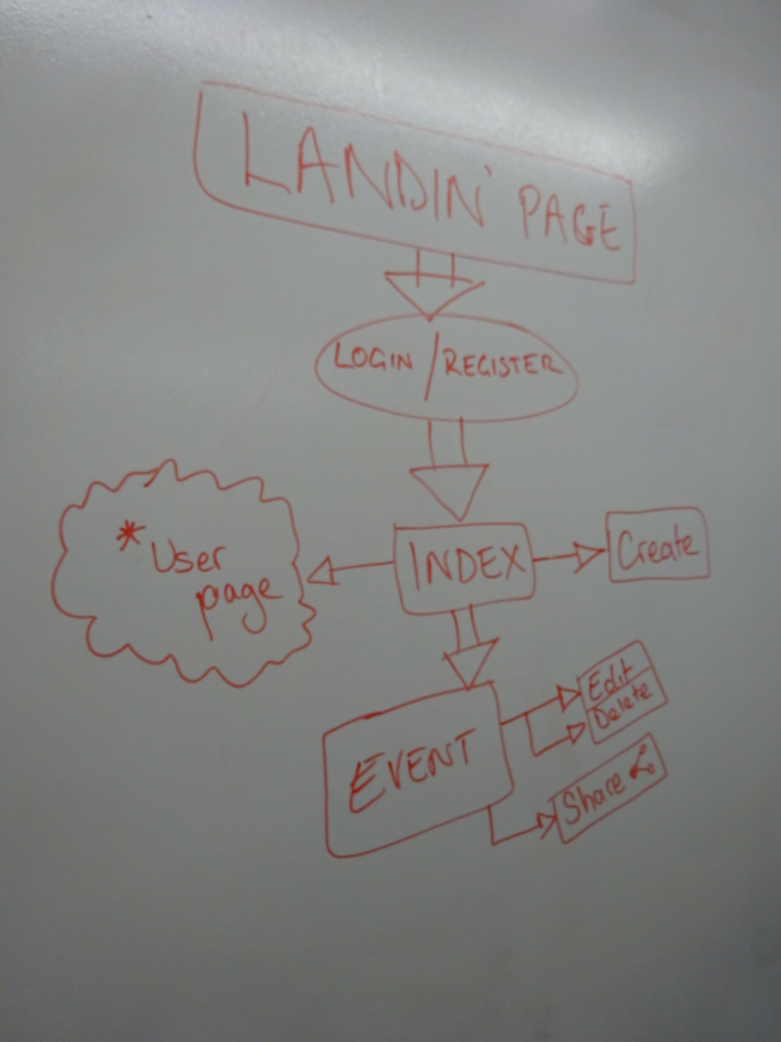
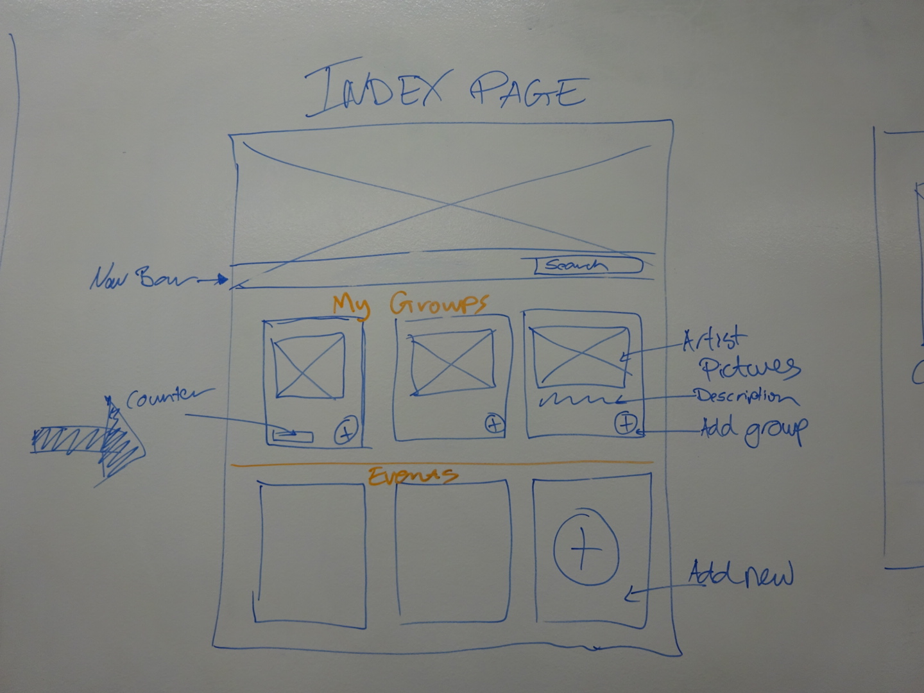
LANDING PAGE
INDEX PAGE
INITIAL SKETCHES
TEAM PLANNING

